Slide 1
Preprocessing in RHESSys

Slide 2
Processing spatial inputs in GRASS GIS
Inputs
Maps Generated
Digital-elevation model (USGS)
DEM map
Slope map
Watershed Gauge
Aspect map
East horizon map
Land-cover map (NLCD)
West horizon map
Drainage map
Other characteristics
Basin map
Hillslope map
Patch map
Zone map
Vegetation map
Stream network
Other maps
(canopy cover, etc.)

Slide 3
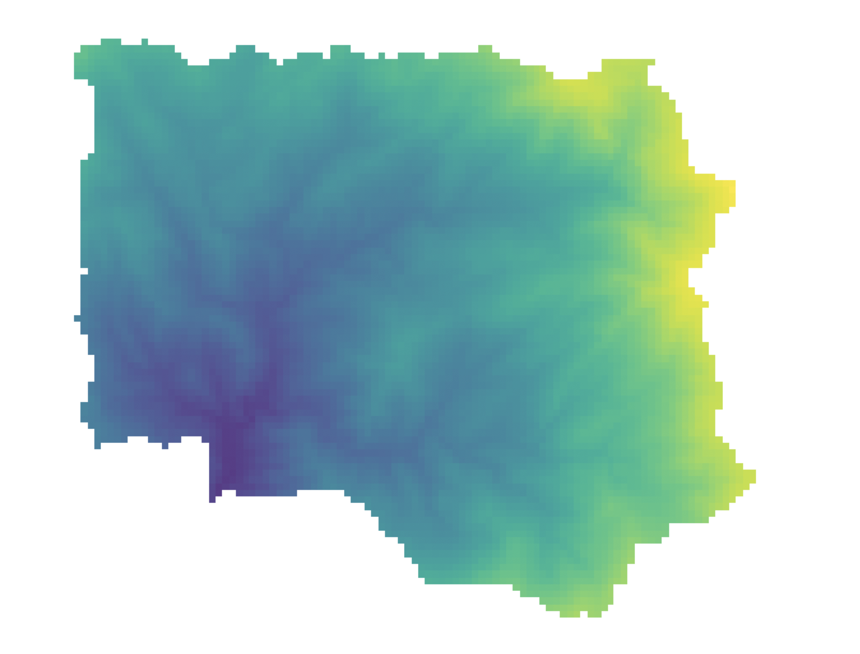
Processing spatial inputs in GRASS GIS
Inputs
Maps Generated
Digital-elevation model (USGS)
DEM map
Slope map
Watershed Gauge
Aspect map
East horizon map
Land-cover map (NLCD)
West horizon map
Drainage map
Other characteristics
Basin map
Hillslope map
Patch map
Zone map
Vegetation map
Stream network
Other maps
(canopy cover, etc.)

Slide 4
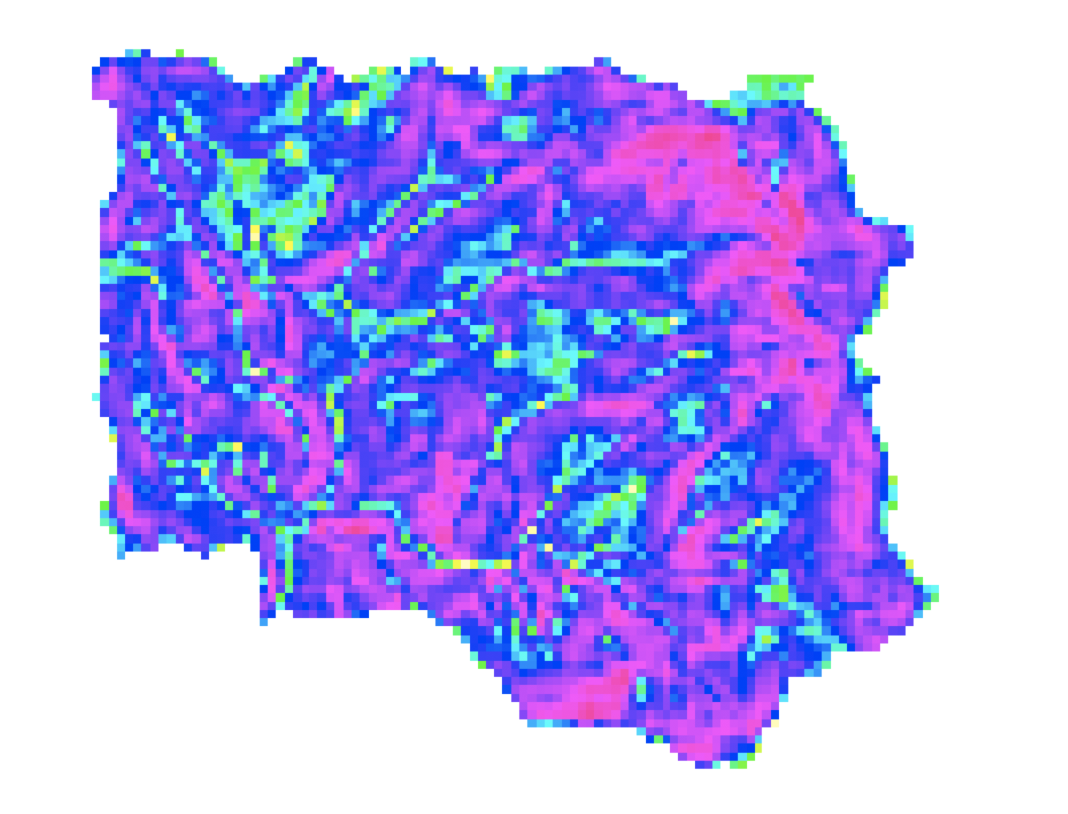
Processing spatial inputs in GRASS GIS
Inputs
Maps Generated
Digital-elevation model (USGS)
DEM map
Slope map
Watershed Gauge
Aspect map
East horizon map
Land-cover map (NLCD)
West horizon map
Drainage map
Other characteristics
Basin map
Hillslope map
Patch map
Zone map
Vegetation map
Stream network
Other maps
(canopy cover, etc.)

Slide 5
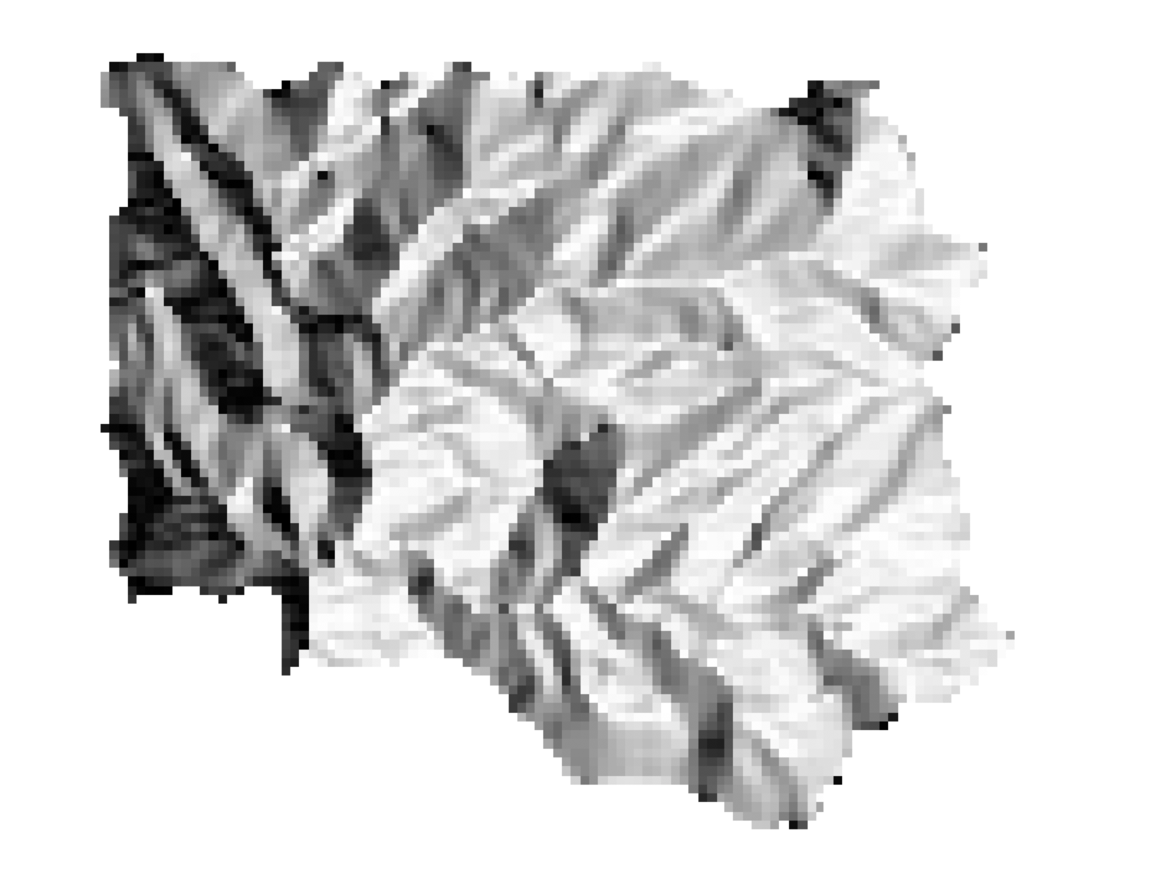
Processing spatial inputs in GRASS GIS
Inputs
Maps Generated
Digital-elevation model (USGS)
DEM map
Slope map
Watershed Gauge
Aspect map
East horizon map
Land-cover map (NLCD)
West horizon map
Drainage map
Other characteristics
Basin map
Hillslope map
Patch map
Zone map
Vegetation map
Stream network
Other maps
(canopy cover, etc.)

Slide 6
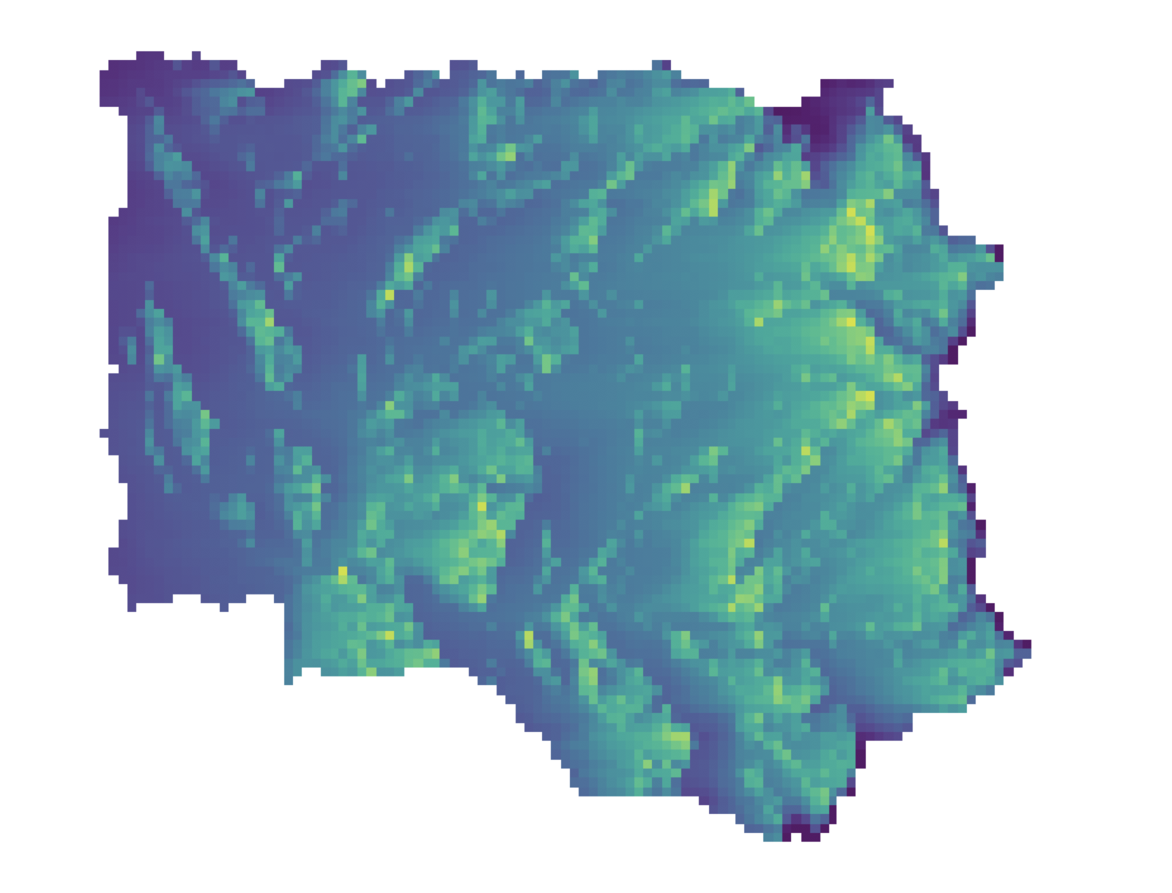
Processing spatial inputs in GRASS GIS
Inputs
Maps Generated
Digital-elevation model (USGS)
DEM map
Slope map
Watershed Gauge
Aspect map
East horizon map
Land-cover map (NLCD)
West horizon map
Drainage map
Other characteristics
Basin map
Hillslope map
Patch map
Zone map
Vegetation map
Stream network
Other maps
(canopy cover, etc.)

Slide 7
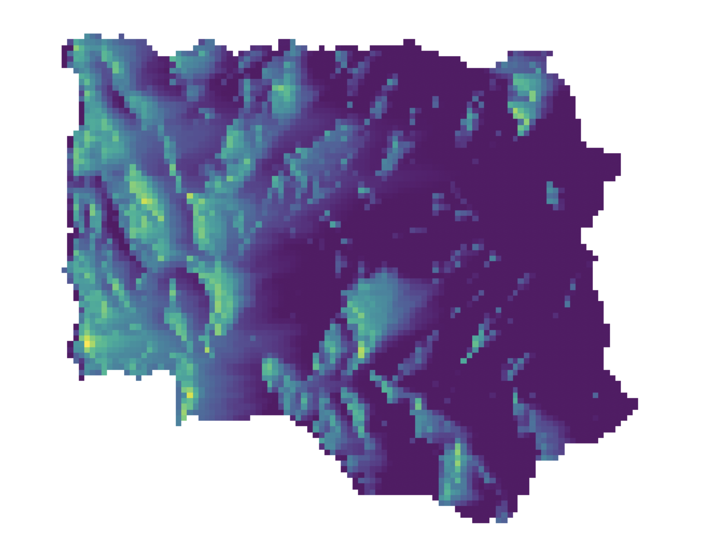
Processing spatial inputs in GRASS GIS
Inputs
Maps Generated
Digital-elevation model (USGS)
DEM map
Slope map
Watershed Gauge
Aspect map
East horizon map
Land-cover map (NLCD)
West horizon map
Drainage map
Other characteristics
Basin map
Hillslope map
Patch map
Zone map
Vegetation map
Stream network
Other maps
(canopy cover, etc.)

Slide 8
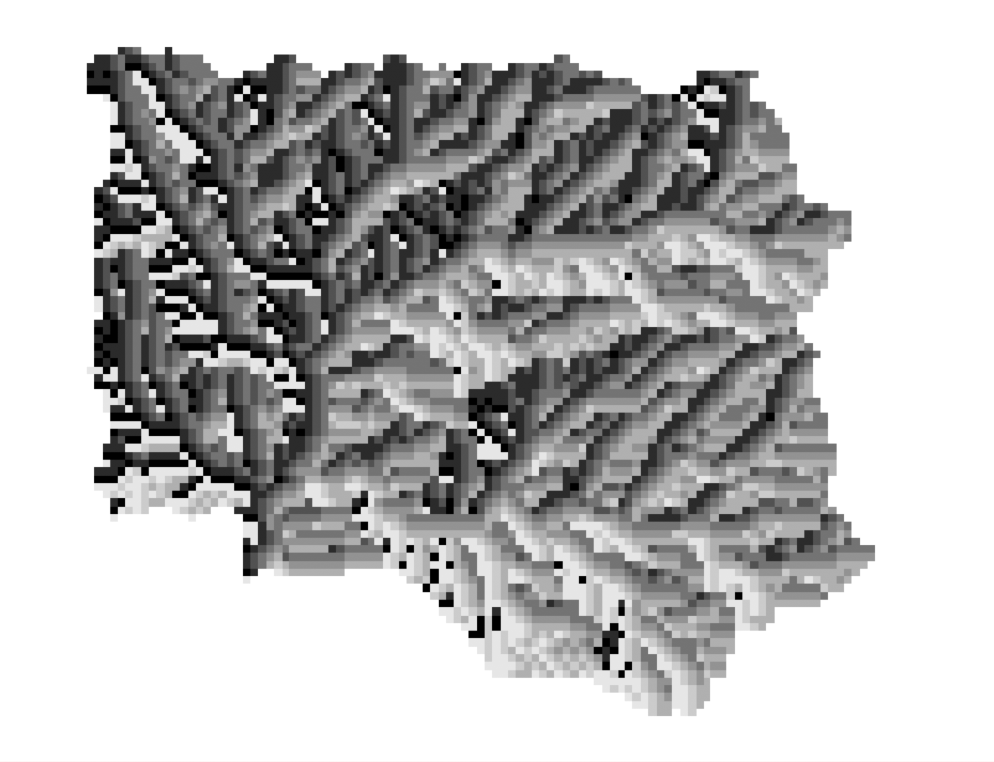
Processing spatial inputs in GRASS GIS
Inputs
Maps Generated
Digital-elevation model (USGS)
DEM map
Slope map
Watershed Gauge
Aspect map
East horizon map
Land-cover map (NLCD)
West horizon map
Drainage map
Other characteristics
Basin map
Hillslope map
Patch map
Zone map
Vegetation map
Stream network
Other maps
(canopy cover, etc.)

Slide 9

Processing spatial inputs in GRASS GIS
Inputs
Maps Generated
Digital-elevation model (USGS)
DEM map
Slope map
Watershed Gauge
Aspect map
East horizon map
Land-cover map (NLCD)
West horizon map
Drainage map
Other characteristics
Basin map
Hillslope map
Patch map
Zone map
Vegetation map
Stream network
Other maps
(canopy cover, etc.)

Slide 10
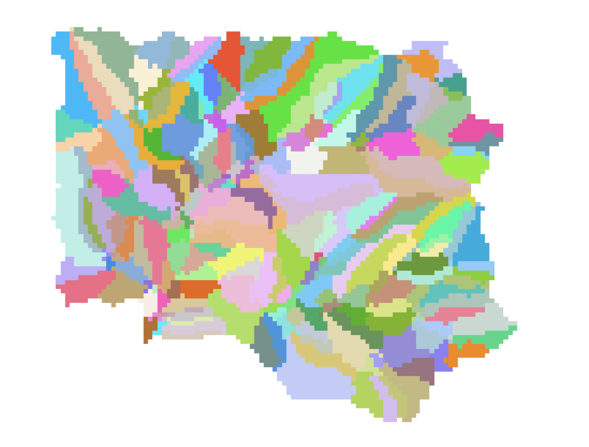
Processing spatial inputs in GRASS GIS
Inputs
Maps Generated
Digital-elevation model (USGS)
DEM map
Slope map
Watershed Gauge
Aspect map
East horizon map
Land-cover map (NLCD)
West horizon map
Drainage map
Other characteristics
Basin map
Hillslope map
Patch map
Zone map
Vegetation map
Stream network
Other maps
(canopy cover, etc.)

Slide 11
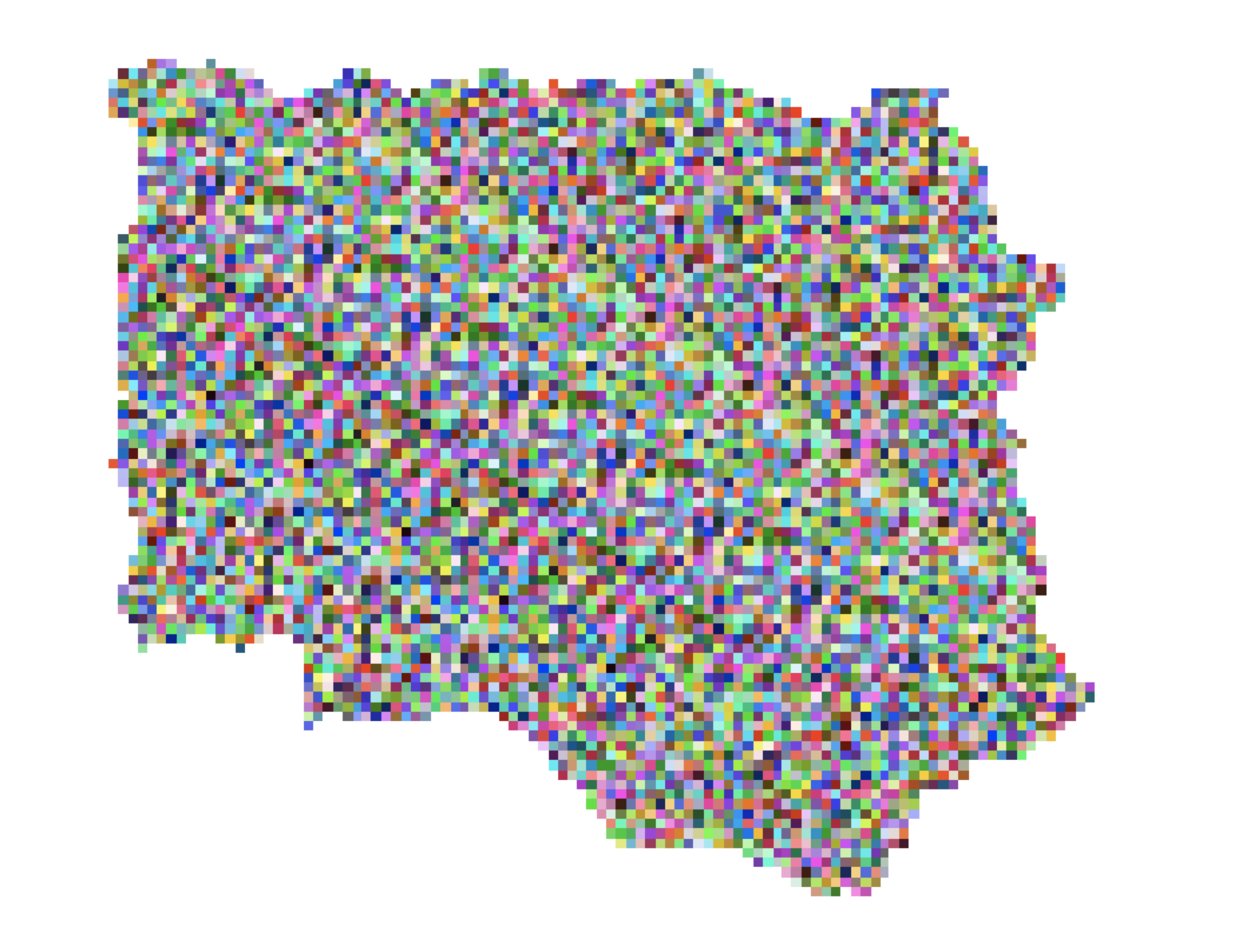
Processing spatial inputs in GRASS GIS
Inputs
Maps Generated
Digital-elevation model (USGS)
DEM map
Slope map
Watershed Gauge
Aspect map
East horizon map
Land-cover map (NLCD)
West horizon map
Drainage map
Other characteristics
Basin map
Hillslope map
Patch map
Zone map
Vegetation map
Stream network
Other maps
(canopy cover, etc.)

Slide 12
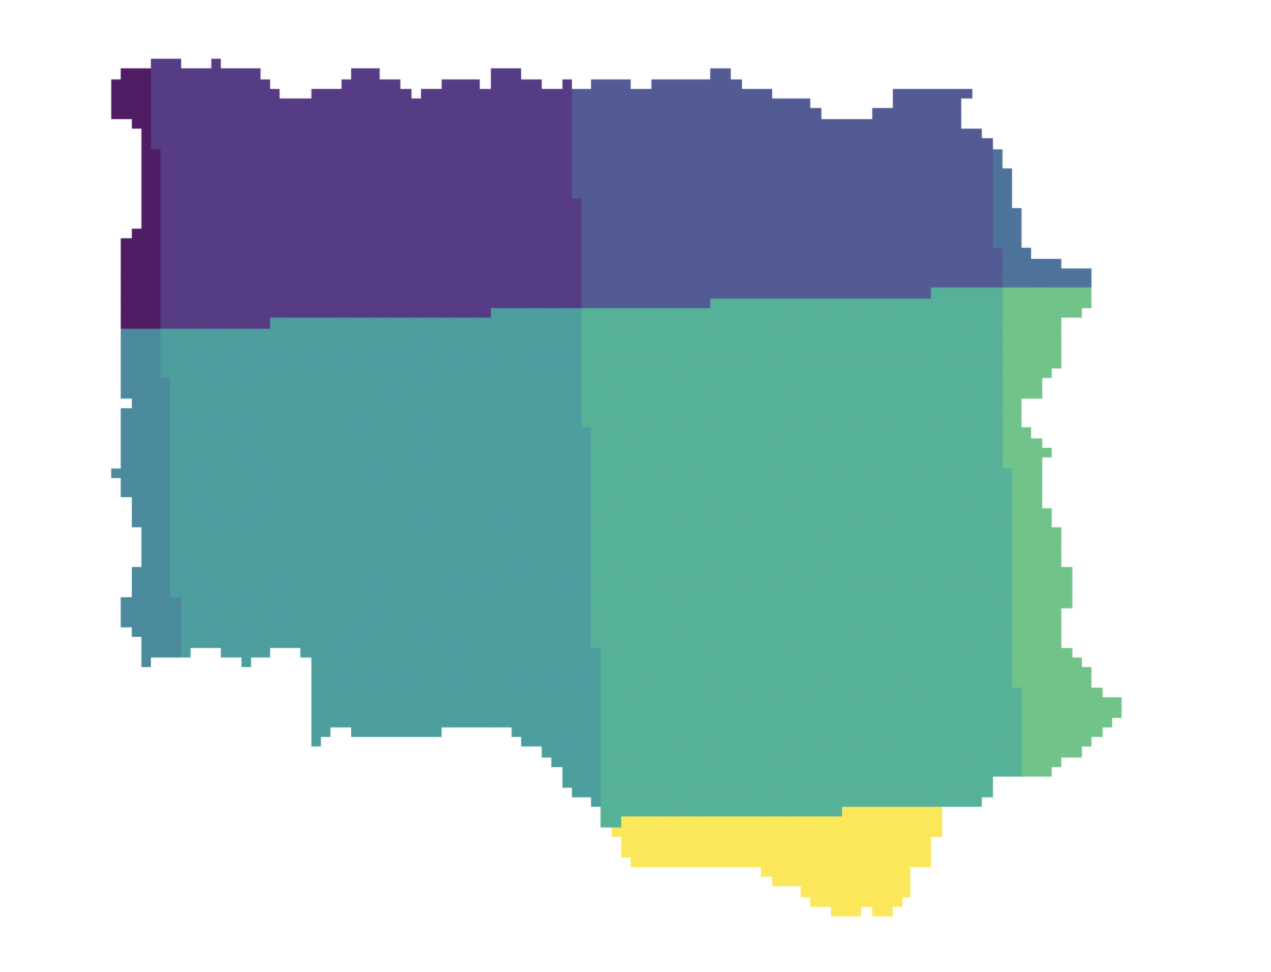
Processing spatial inputs in GRASS GIS
Inputs
Maps Generated
Digital-elevation model (USGS)
DEM map
Slope map
Watershed Gauge
Aspect map
East horizon map
Land-cover map (NLCD)
West horizon map
Drainage map
Other characteristics
Basin map
Hillslope map
Patch map
Zone map
Vegetation map
Stream network
Other maps
(canopy cover, etc.)

Slide 13
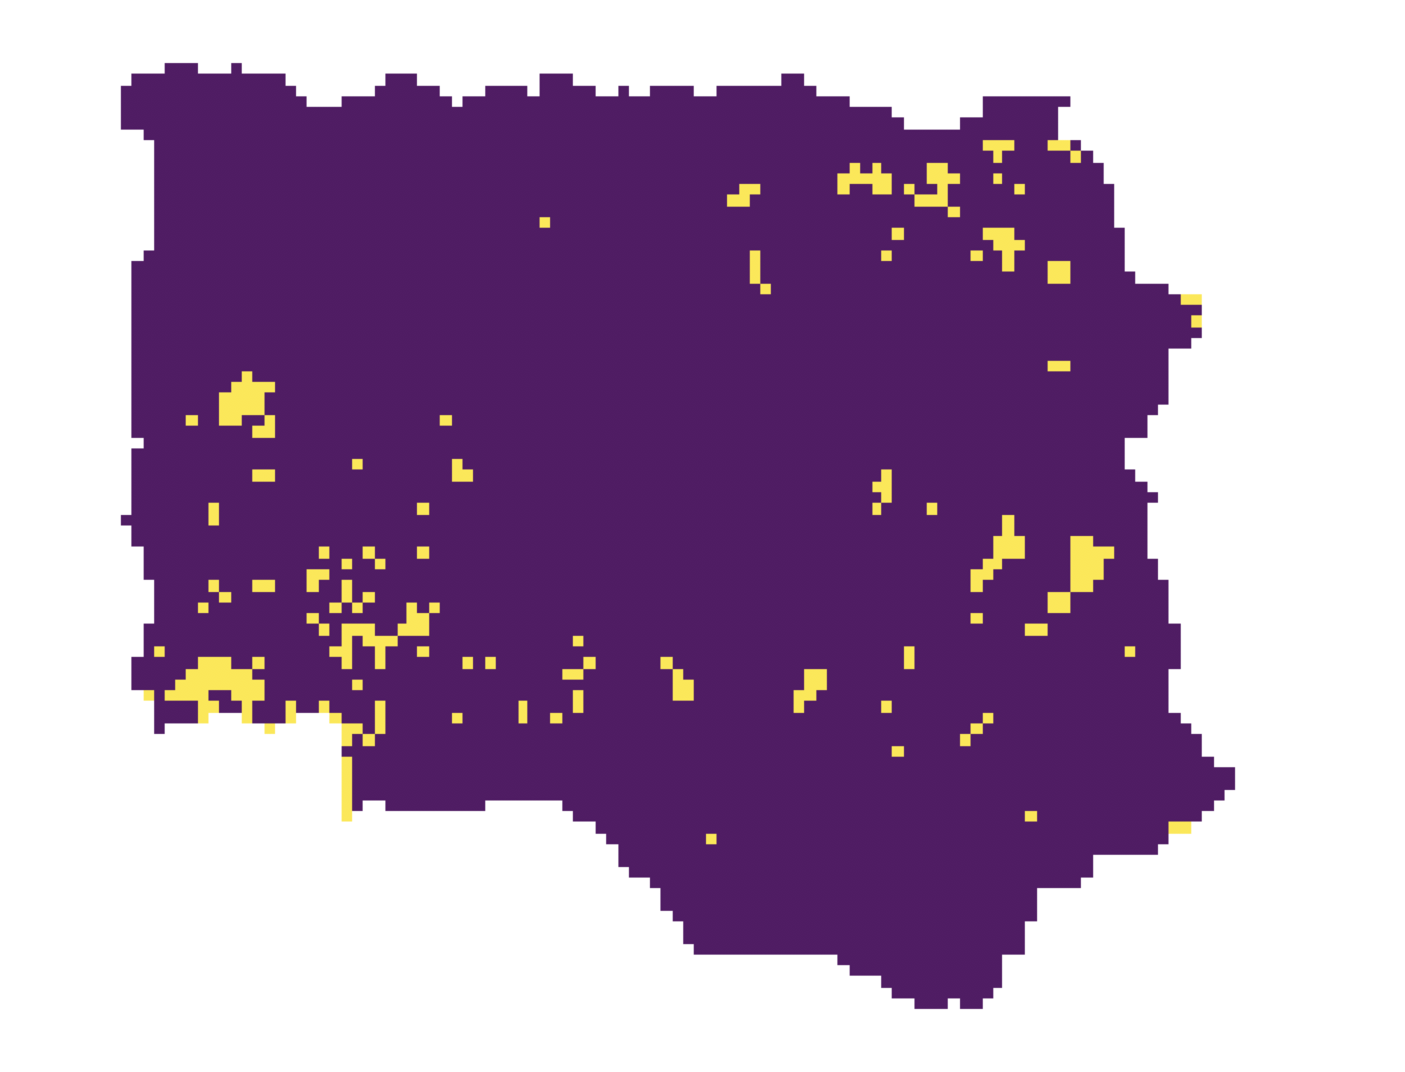
Processing spatial inputs in GRASS GIS
Inputs
Maps Generated
Digital-elevation model (USGS)
DEM map
Slope map
Watershed Gauge
Aspect map
East horizon map
Land-cover map (NLCD)
West horizon map
Drainage map
Other characteristics
Basin map
Hillslope map
Patch map
Zone map
Vegetation map
Stream network
Other maps
(canopy cover, etc.)

Slide 14
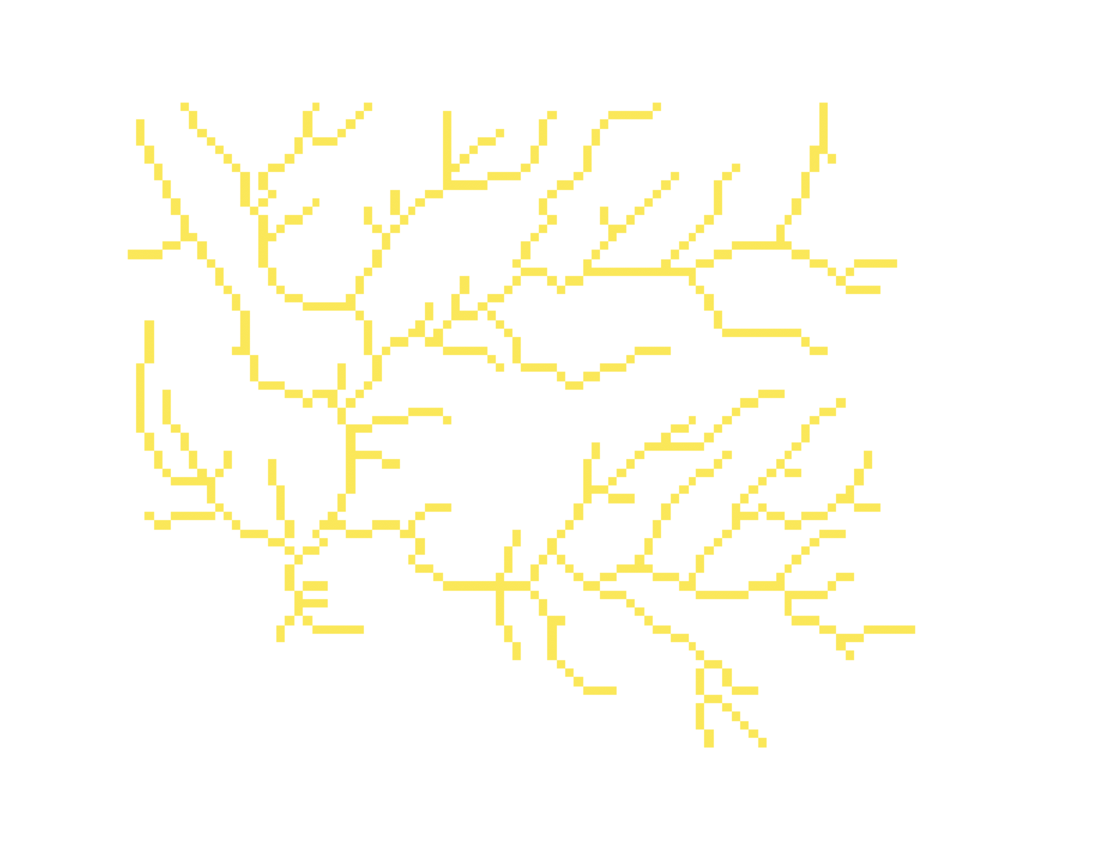
Processing spatial inputs in GRASS GIS
Inputs
Maps Generated
Digital-elevation model (USGS)
DEM map
Slope map
Watershed Gauge
Aspect map
East horizon map
Land-cover map (NLCD)
West horizon map
Drainage map
Other characteristics
Basin map
Hillslope map
Patch map
Zone map
Vegetation map
Stream network
Other maps
(canopy cover, etc.)

Slide 15
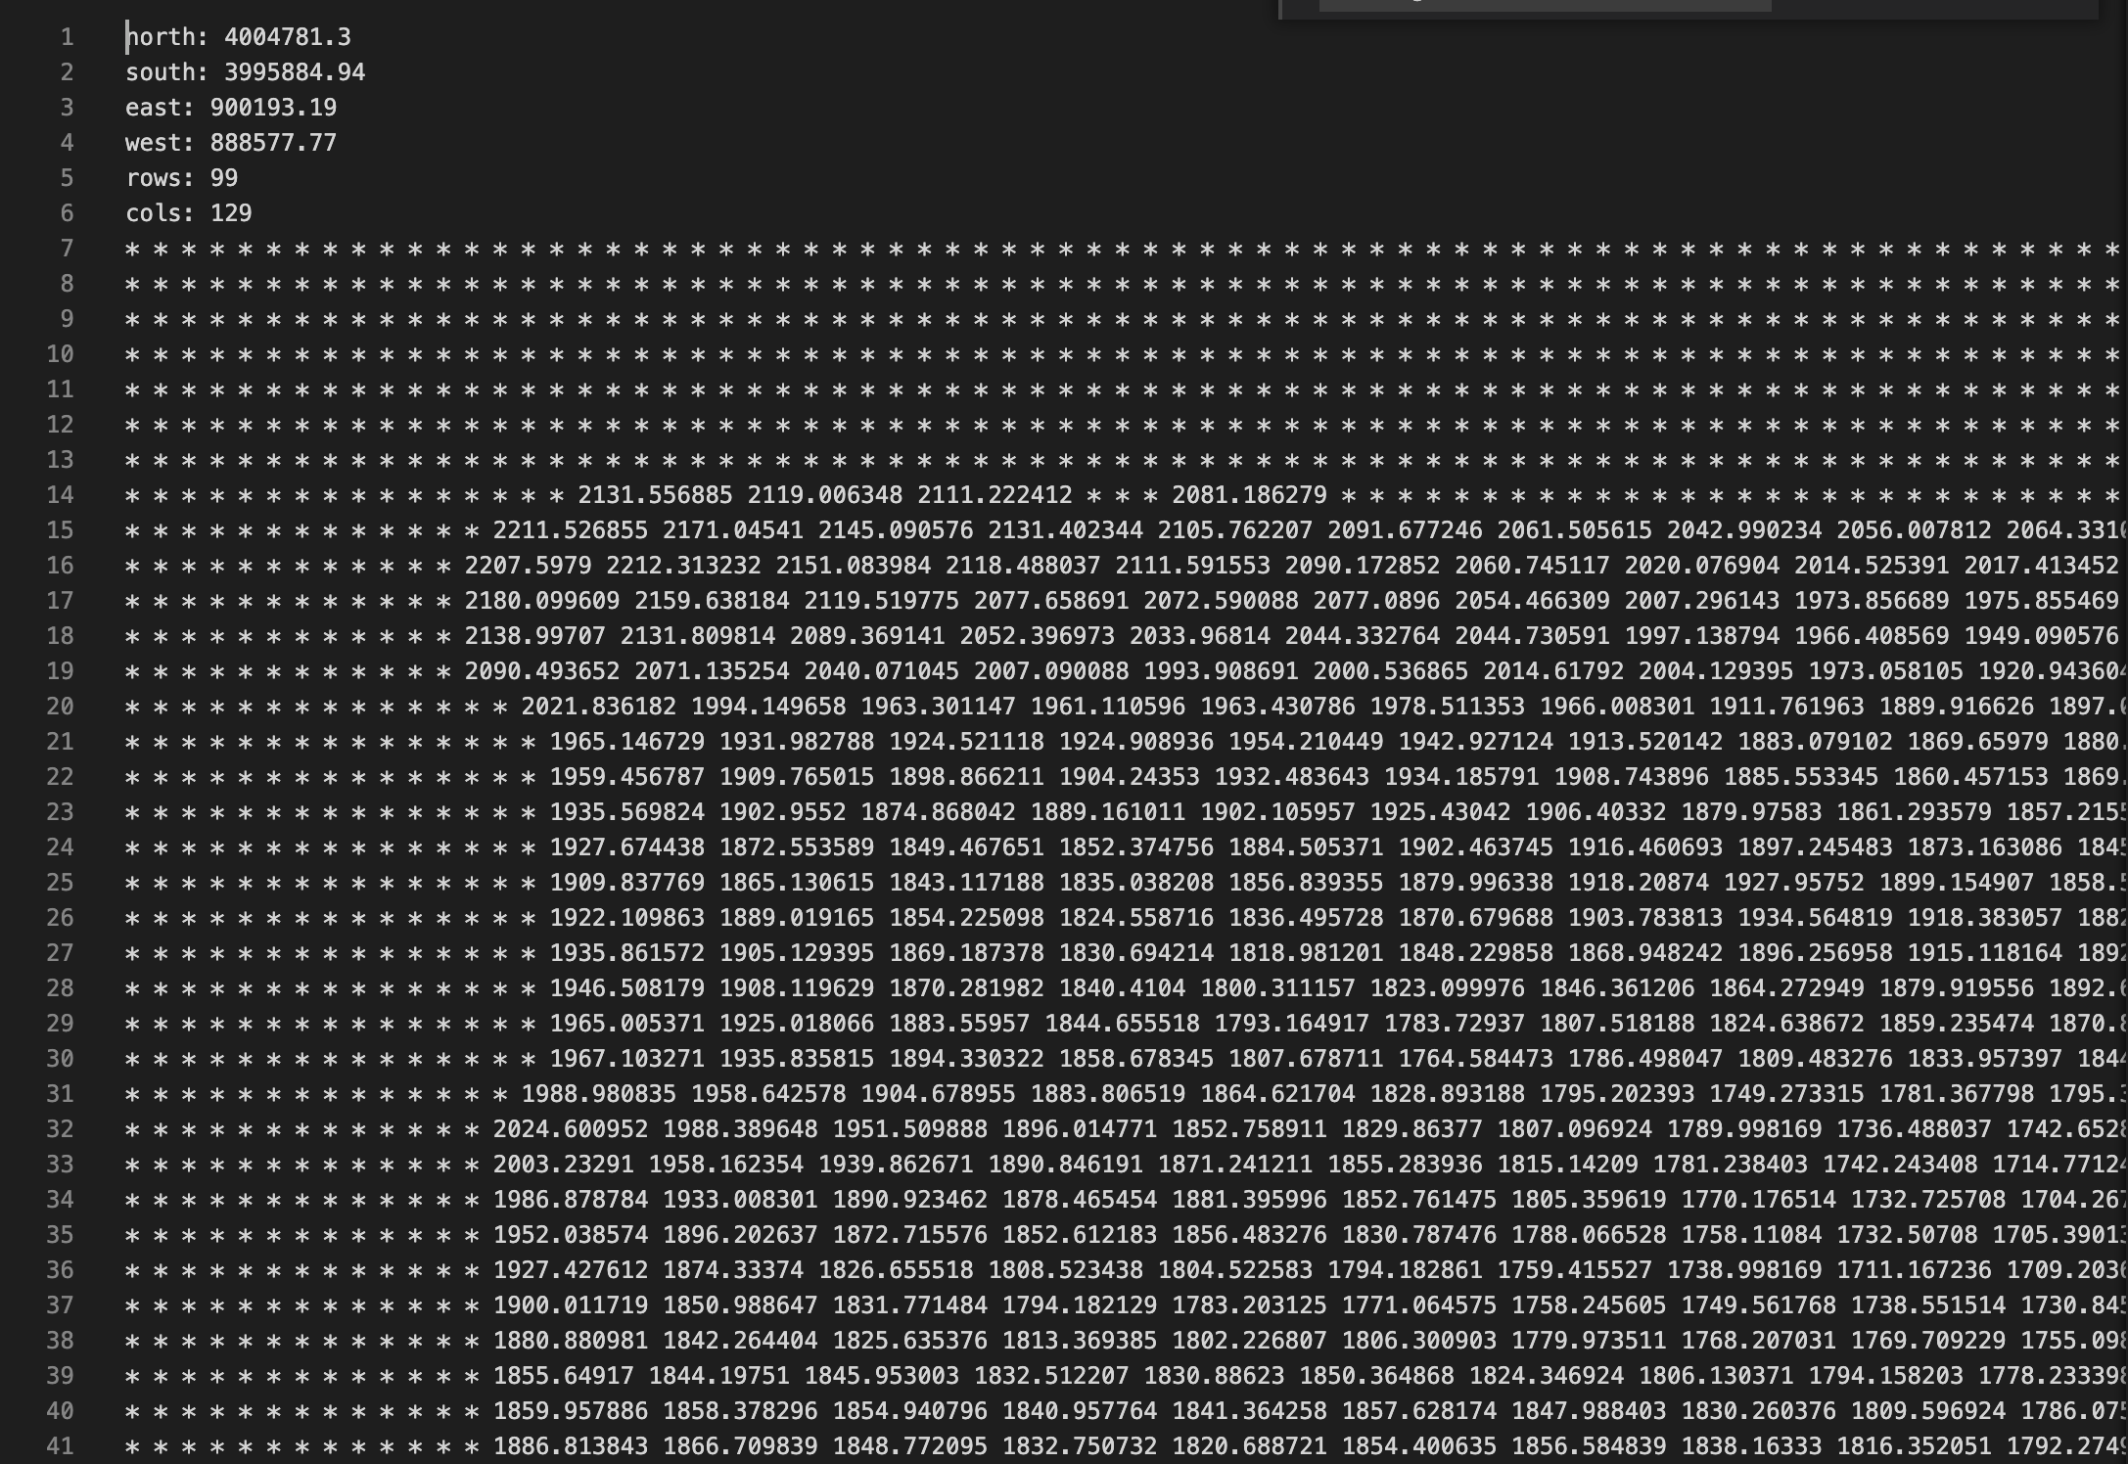
Export maps to ascii
DEM example for South Fork Tule River

Slide 16
RHESSysPreProcessing
R function (RHESSysPreprocess)
Converts ASCII maps to flow table and worldfile
Options for multi-scale routing

Slide 17
Assembling climate data
Standard climate input (Station data)
Gridded climate Input
NetCDF

